Slide 1
RMO Case Study

Slide 2
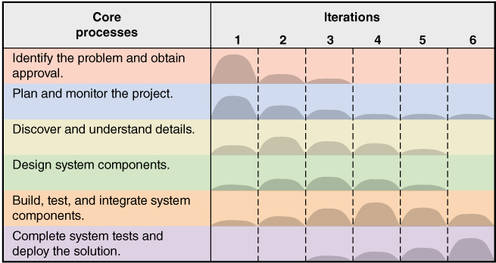
Iterative and Agile Systems Development Lifecycle (SDLC)

Slide 3
Ridgeline Mountain Outfitters (RMO)
Large Retail Company
  Outdoor and sporting clothing and accessories
  Skiing, mountain biking, water sports
  Hiking, camping, mountain climbing
Rocky Mountain and Western States
  Started mail order and phone order
  Added retail stores
  Added extensive E-business component

Slide 4


Slide 5
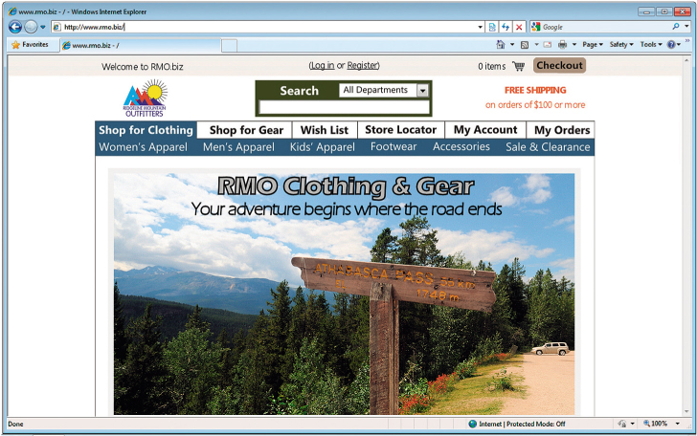
Ridgeline Mountain Outfitters (RMO)

Slide 6
RMO Tradeshow System
Sample project for chapter
Small information system (app)
Being added to larger supply chain management system
Demonstrates one iteration of the small project – assumes more iterations in total project
Goes through all six core processes of SDLC
The plan for this chapter is to complete iteration in six days

Slide 7
RMO Tradeshow System
Problem-- purchasing agents attend apparel and fabric trade shows around the world to order new products from suppliers
Need– information system (app) to collect and track information about suppliers and new products while at tradeshows
Tradeshow Project– is proposed
  Supplier information subsystem
  Product information subsystem

Slide 8
Initial Activities – pre-project
Identify the problem and document the objective of the system (core process 1)
  Preliminary investigation
  System Vision Document
Obtain approval to commence the project (core process 1)
  Meet with key stakeholders, including executive management
  Decision reached, approve plan and budget

Slide 9
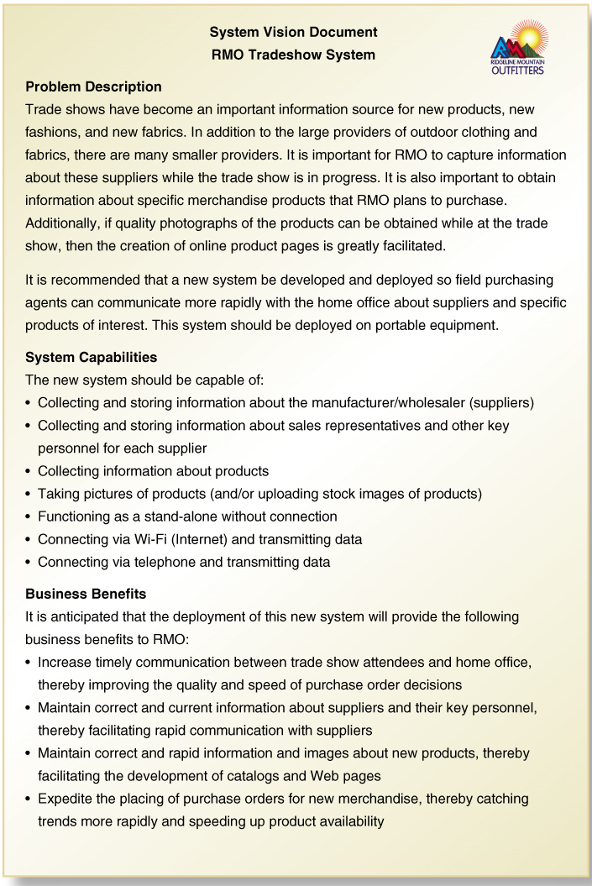
System Vision Document
Problem description
System capabilities
Business benefits

Slide 10
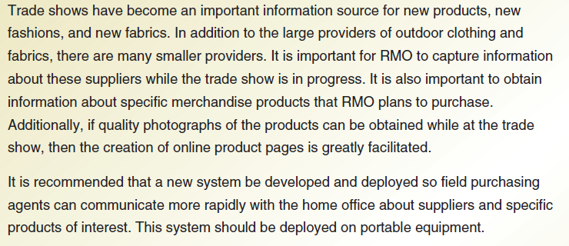
Problem Description

Slide 11
System Capabilities

Slide 12
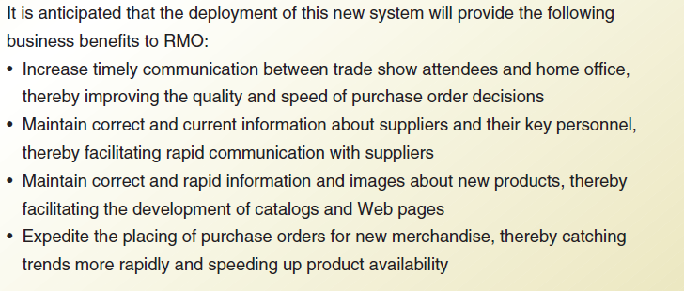
Business Benefits

Slide 13
Day 1 Activities
Core Process 2: Plan the Project
  Determine the major components (functional areas) that are needed
    Supplier information subsystem
    Product information subsystem
  Define the iterations and assign each function to an iteration
    Decide to do Supplier subsystem first
    Plan one iteration as it is small and straight forward
  Determine team members and responsibilities

Slide 14
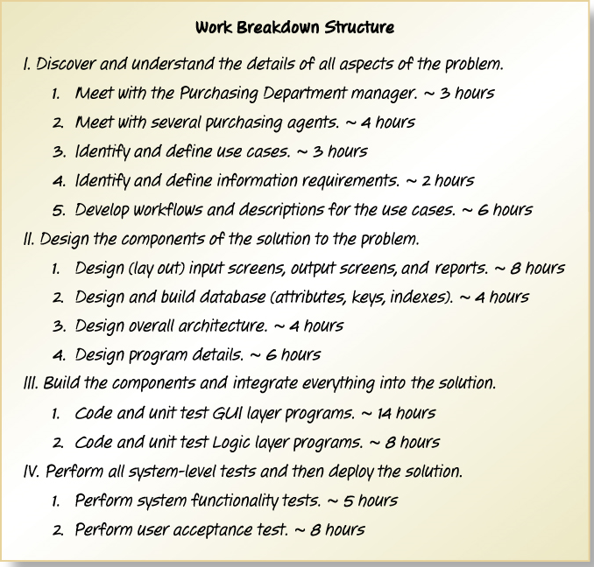
Work Breakdown Structure for Iteration
Describes the work and covers Core Processes 3, 4, 5, and 6

Slide 15
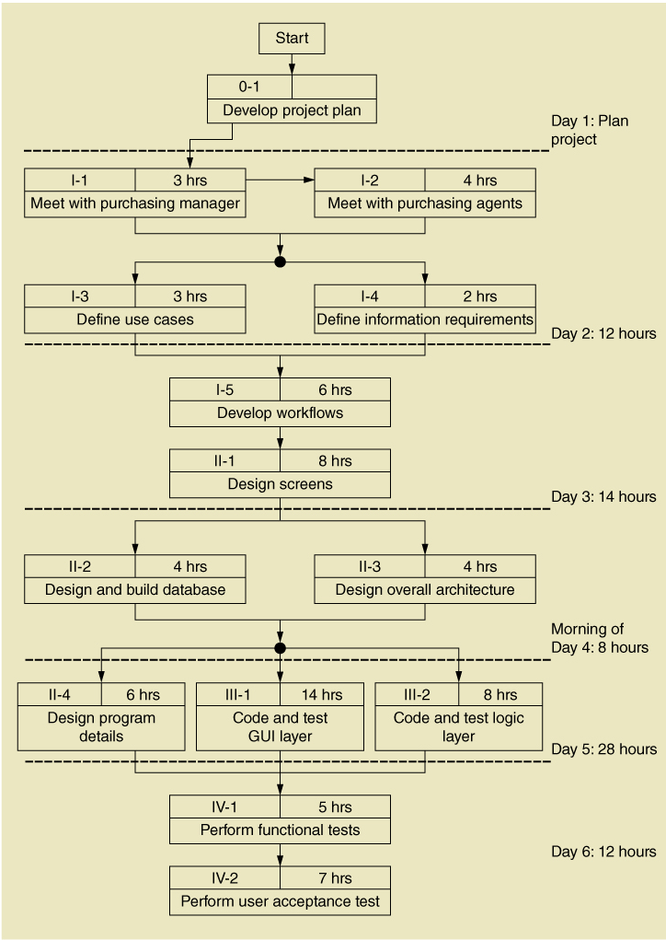
Work Sequence Draft for Iteration
Elaborates the Work Breakdown Structure

Slide 16
Day 2 Activities
Core Process 3: Discover and Understand Details
  Do preliminary fact-finding to understand requirements
  Develop a preliminary list of use cases and a use case diagram
  Develop a preliminary list of classes and a class diagram

Slide 17
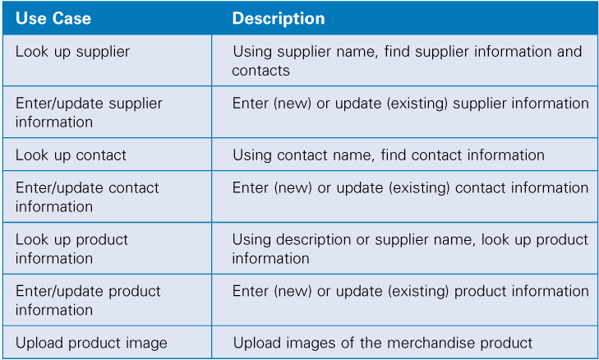
Identify Use Cases
Both subsystems

Slide 18
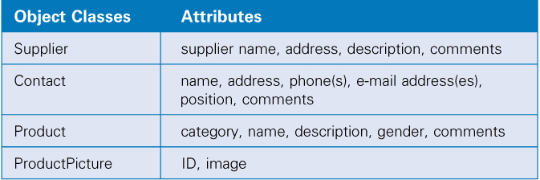
Identify Object Classes
Both subsystems

Slide 19
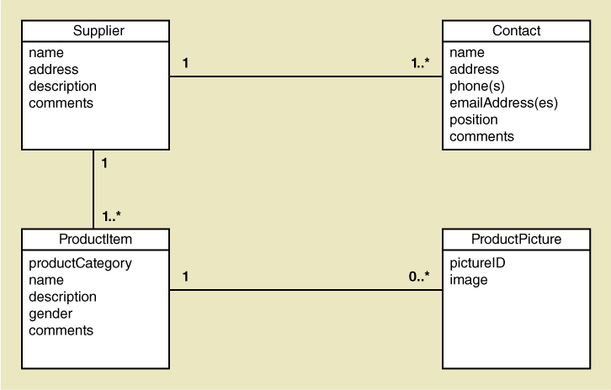
Preliminary Class Diagram
Both subsystems

Slide 20
Day 3 Activities
Core Process 3: Discover and Understand Details
  Do in-depth fact-finding to understand requirements
  Understand and document the detailed workflow of each use case
Core Process 4: Design System Components
  Define the user experience with screens and report sketches

Slide 21
Supplier Information Subsystem
Use cases:
  Look up supplier
  Enter/update supplier information
  Lookup contact information
  Enter/update contract information

Slide 22
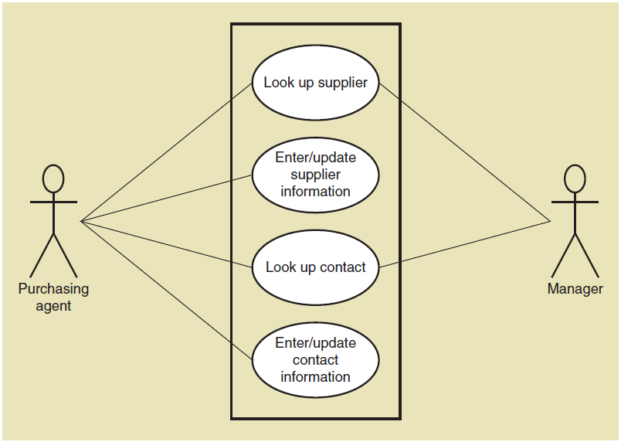
Use Case Diagram
Supplier information subsystem

Slide 23
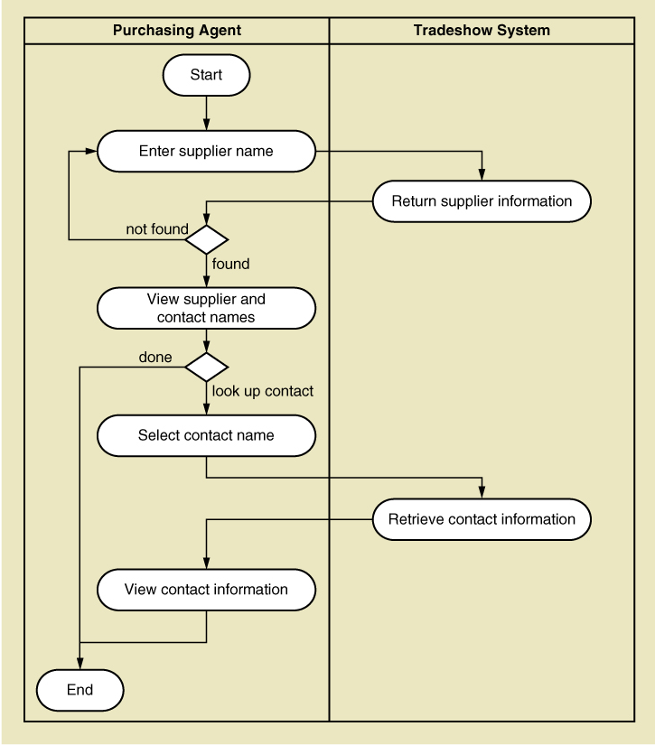
Activity Diagram (Workflow)
Look up supplier use case

Slide 24
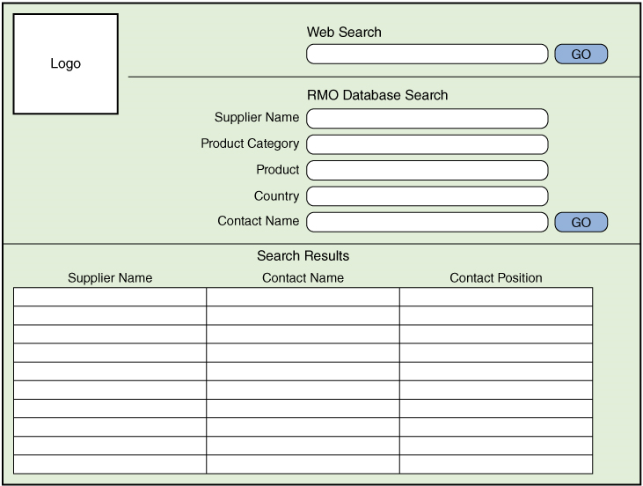
Draft Screen Layout
Look up supplier use case

Slide 25
Day 4 Activities
Core Process 4: Design System Components
  Design the database (schema)
  Design the system’s high level structure
    Browser, Windows, or Smart phone
    Architectural configuration (components)
    Design class diagram
    Subsystem architectural design

Slide 26
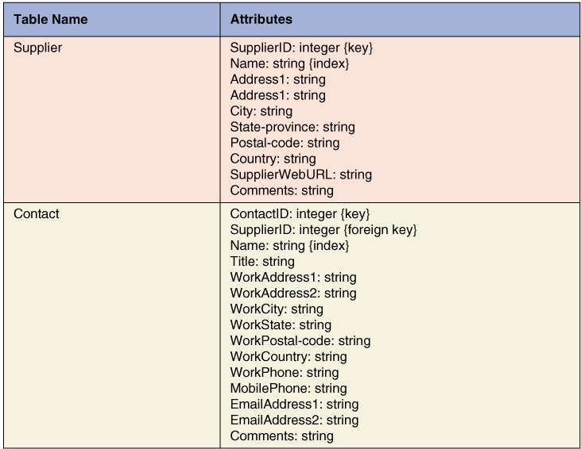
Database Schema

Slide 27
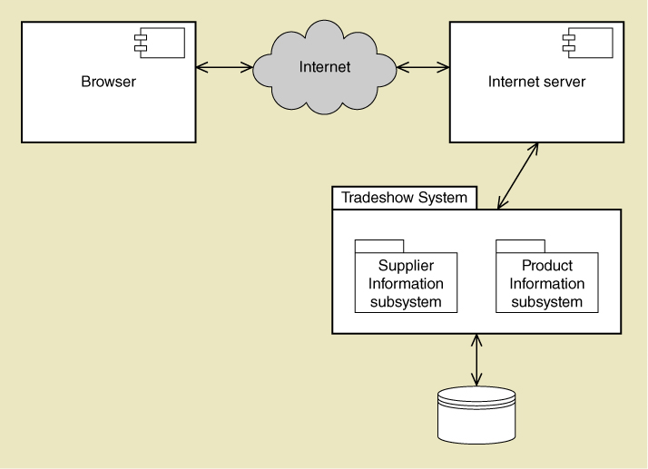
Architectural Configuration Diagram

Slide 28
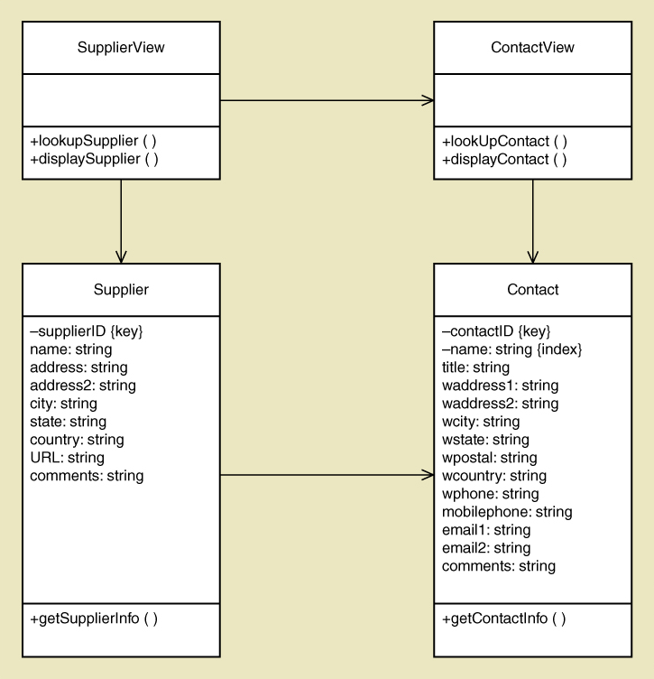
Preliminary Design Class Diagram
Includes View Layer Classes and Domain Layer Classes

Slide 29
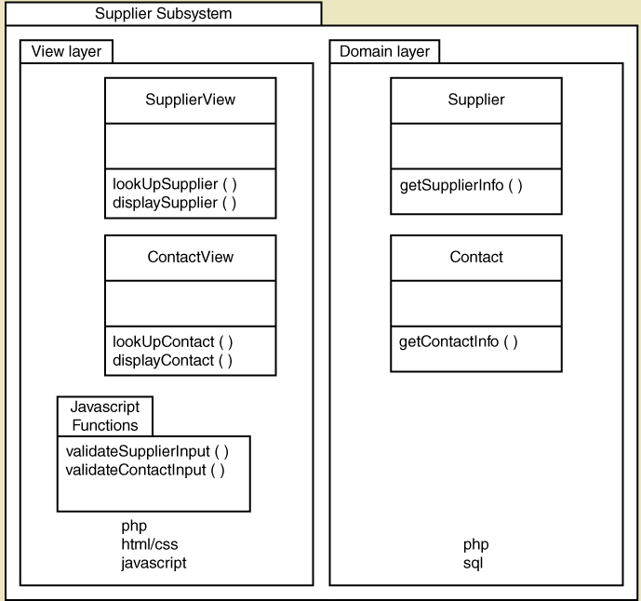
Subsystem Architectural Design Diagram

Slide 30
Notes on Managing the Project
Lots of design diagrams shown
  Design in a complex activity with multiple levels
  One diagram builds on/complements another
  Not everything is diagrammed, especially for a small project. Pick and choose.
Programming is also done concurrently
  You don’t design everything then code
  You do some design, some coding, some design, some coding

Slide 31
Day 5 Activities
Core Process 4: Design System Components
  Continue with design details
  Proceed use case by use case
Core Process 5: Build, Test, and Integrate System Components
  Continue programming (build)
  Build use case by use case
  Perform unit and integration tests

Slide 32
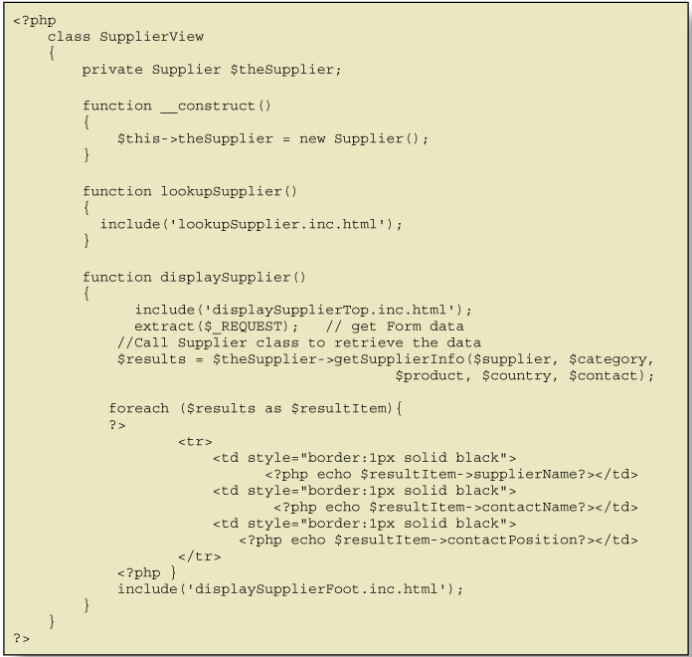
Code Example for One Class

Slide 33
Day 6 Activities
Core Process 6: Complete System Testing and Deploy the System
  Perform system functional testing
  Perform user acceptance testing
  Possibly deploy part of system

Slide 34
Workflow of Testing Tasks

Slide 35
First Iteration Recap
This was a 6 day iteration of small project
  Most iterations are longer (2 to 4 weeks)
  This project might be 2 iterations
  Most projects have many more iterations
End users need to be involved, particularly in day 1, 2, 3 and 6.
Days 4 and 5 involved design and programming concurrently.

Slide 36
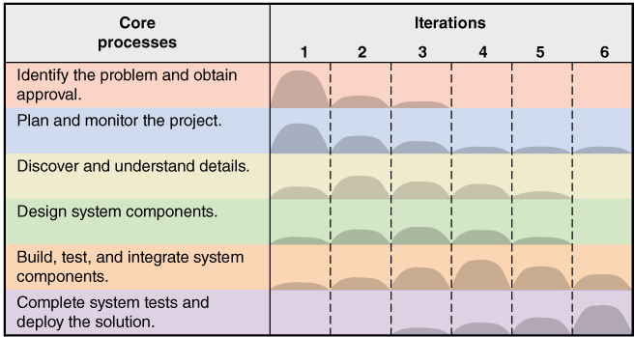
This Book is about Activities and Tasks in the SDLC

